Slide 1
Software Engineering
Lecture 01
Introduction and
Software Process Models
Notes:
Good morning everyone. Welcome to the software engineering class. My name is Lingming Zhang, and I’m the instructor of this class. I just joined UTD CS as an assistant professor this month. So, basically, this is my first class here.

Slide 2
Optional Course Textbooks
One of the following Software Engineering books
Ian Sommerville, “Software Engineering”, 9th Edition, Addison-Wesley, 2011. (Or 8th Edition, Or 7th Edition)
Pressman, “Software Engineering: A Practitioner’s approach”, 7th Edition, McGraw Hill, 2010. (Or 6th Edition, Or 8th Edition )
Pfleeger and Atlee, “Software Engineering: Theory and Practice”, 4th Edition, 2010, Prentice Hall, 2006.

Slide 3

What is Software
Software is a collection of artifacts
Computer programs
Data
Documents

Slide 4
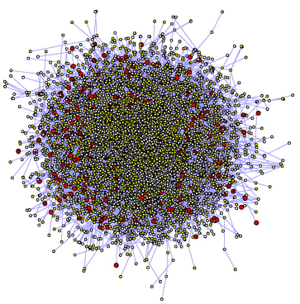
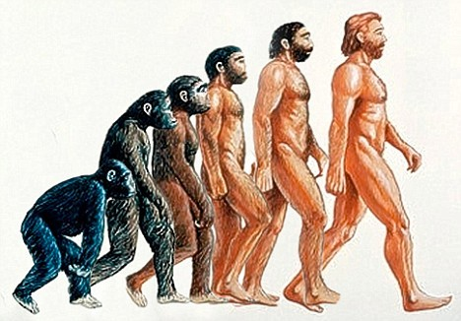
Software Characteristics
Complexity
Evolution

Slide 5
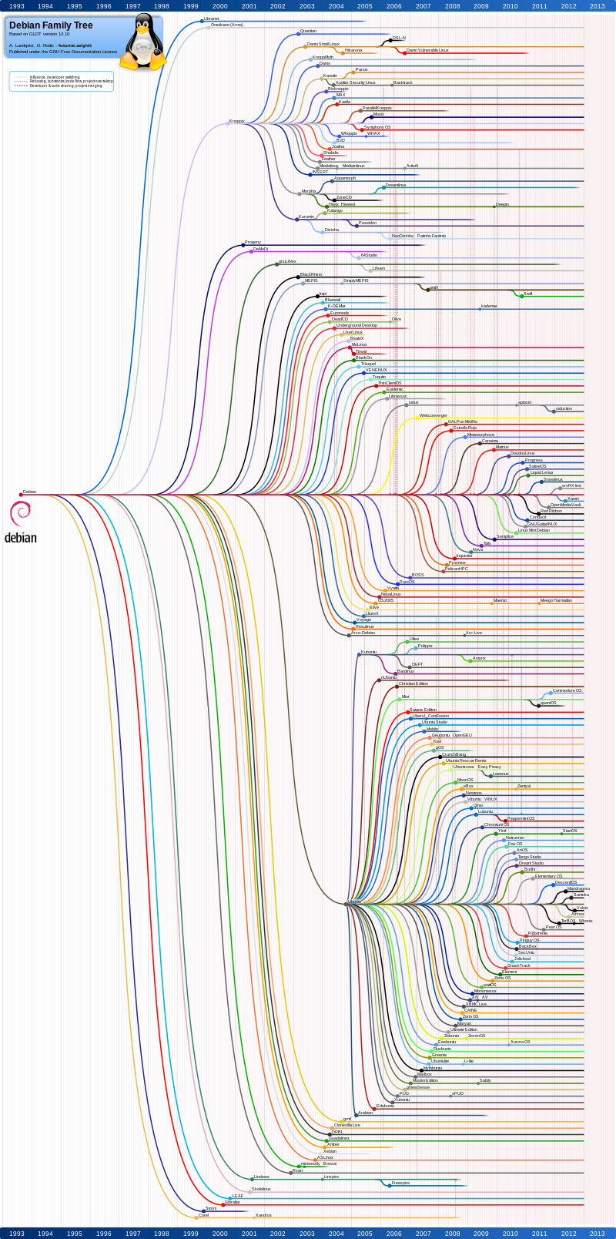
The Debian OS Example
Year | OS | LoC(Million)
2000 | Debian2.2 | 55-59
2002 | Debian3.0 | 104
2005 | Debian3.1 | 215
2007 | Debian4.0 | 283
2009 | Debian5.0 | 324
2012 | Debian7.0 | 419
Complexity
Evolution

Slide 6
What makes quality software
Attributes of quality software
Dependability
reliability, security, and safety
Efficiency
processing time, memory utilization, responsiveness,
Usability
appropriate user interface and adequate documentation
Maintainability
ease of change
Notes:
reliability describes the ability of a system or component to function under stated conditions for a specified period of time.

Slide 7
What is software engineering
Software engineering is the establishment and use of sound engineering principles in order to obtain economically software that is reliable and works efficiently on real machines
[by Prof. Fritz Bauer at the 1968 NATO conference on software technology, in Garmisch, Germany]
In short, software engineering is about developing quality software in a productive way

Slide 8
Software Engineering
vs. Computer Science
Computer science focuses on theory and fundamentals
Software engineering is concerned with the practical issues in developing and delivering useful software

Slide 9
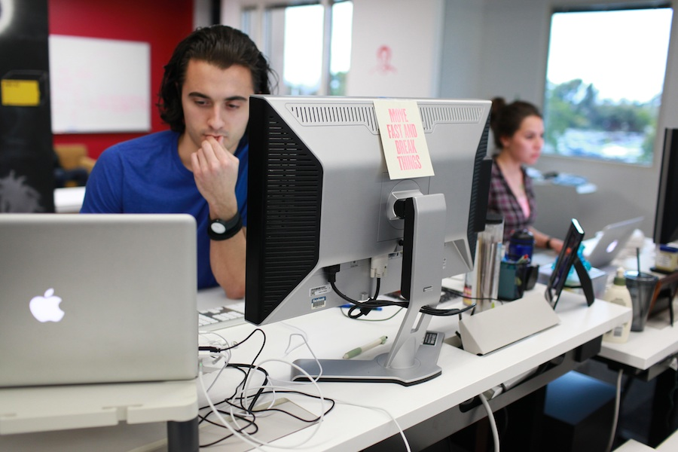

Software Engineering vs. Civil Engineering -- Similarities
Size matters
Teamwork with careful planning
Leverage components
Penalties for failures
Sharing terms: building, architecture, components, …
Notes:
et cetera

Slide 10
Software Engineering vs. Civil Engineering -- Differences
Much Harder to predict the behavior of the software
Physics laws guide civil engineering, no such laws for software
Software systems are more complex (incomputable)
Complex features so that user behaviors are unpredictable
Consider a bridge vs. a notepad program (edit, find/replace, open, save, …)
Need to consider the evolution of software
Software is easier to change
But it is still expensive to change

Slide 11
The Facts
Only 32% of software projects are considered successful (full featured, on time, on budget)
Software failures cost the US economy $59.5 billion dollars every year [NIST 2002 Report]
Blame can be partly passed to:
The engineer
The manager
The customers

Slide 12
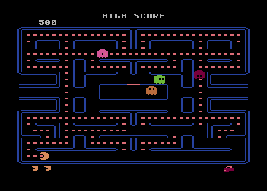
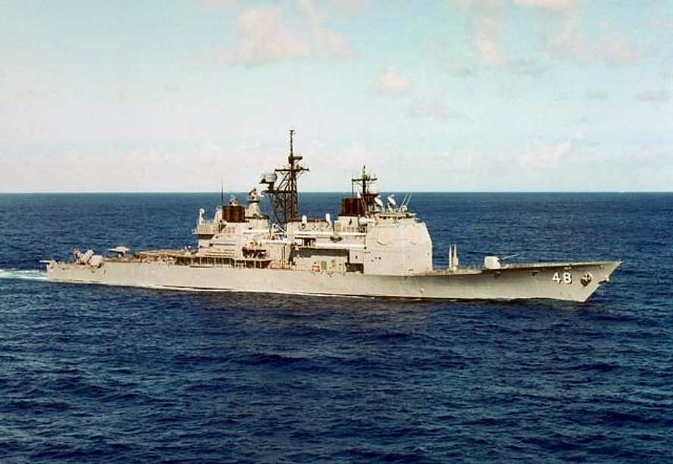
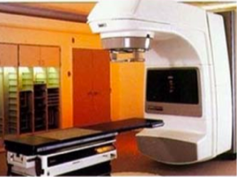
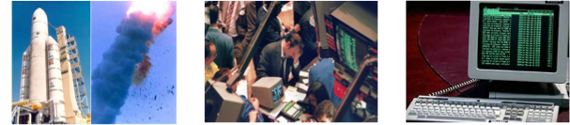
Software Failure Examples
Pac-Man
USS Yorktown
Therac-25
ESA Ariane 5 F501
Wall Street Crash
Y2000 Bug
Notes:
1. Pac-Man has a kill screen on level 256 based on an integer overflow.
2. USS Yorktown was left dead in the water in 1997 for 3 hours after a divide by zero error.
3. A number of patients received up to 100 times the intended radiation, and at least three of them died.
4. Destroyed 40 seconds after takeoff (June 4, 1996). The US$1 billion prototype rocket self-destructed due to a bug in the on-board guidance software.
5. Over $500 billion was lost from the Dow Jones Index.October 19, 1987
6. $500 billion for year 2000bug

Slide 13
Engineer’s fault
Let’s just write the code, so that we will be done sooner
I have to finish it to assess its quality
Writing code sooner may cause it take longer to finish
80% of effort is spent after the first delivery of code
Design reviews help to find severe design defects
Good coding style leads to fewer bugs
Static checker and unit testing help to find bugs earlier

Slide 14
Engineer’s fault (Cont’d)
There is no time for software engineering
It will take you more time without software engineering
Misunderstood requirements (may need to redo the whole thing)
Comprehensive design / code changes for feature changes
Tons of Bug fixes

Slide 15
When do Engineers do Software Engineering
Consider the following cases:
Write a text format changer for one-time usage
(nothing)
Write a personal utility library
(+design for potential change, +testing)
Write a notepad program to share online
(+requirement collection, + usage documentation)
Collaborate on a small project with several people
(+modeling, +API doc, +comments, +version control)
Work on a large project in a large company
(+design documentation, +coding style, +code review, +static checker, +other regulations)

Slide 16
Manager’s fault
We add more programmers if we are late
We can outsource it
Adding programmers to a late software, makes it later [The mythical man-month, Fred Brooks]
If you do not manage it well inside, you cannot do it well outside
Much more communications, more risk for requirement misunderstanding
Impairs long-term maintenance

Slide 17
Customer’s fault
We do not need to be involved in the project
Anyway, we can change the software later
Customers should be involved all the time to provide requirements (requirement are always changing)
Yes, but the cost goes exponentially as time goes by!

Slide 18
Why learn software engineering
Software engineer is the most required jobs in the IT field, and you want to be a successful one of them
Other related positions: requirement engineer, test engineer, etc.
As long as you still write program, software engineering will help you
Notes:
etcetera

Slide 19

Software Engineering: A Layered View
Tools: provide automated or semi-automated supports for the process and the methods
Methods: provide “how to’s” for building software
Process: provides a framework for software development
Notes:
来耳朵

Slide 20
Software Process Models
A process model describes:
What steps you go through
Which development artifacts are produced, and when
How activities are coordinated
Different process models
The waterfall model
The prototyping model
The iterative model
Agile development

Slide 21
The Waterfall Model
Requirement Engineering
Design
Implementation
Integration

Slide 22
Requirement Engineering
Figure out what the software is supposed to do…
Collection
Talking to users, customers, etc. (customers != users)
Sometimes people are not sure about what they want
Some requirements can cost too much (but users/customers do not know)
Notes:
et-set-ra.

Slide 23

Requirement Engineering (Cont’d)
Including functional & non-functional requirements
Functional requirements describe what a software system should do
The correctness of the system
Non-functional requirements place constraints on how the system will do so
Performance, usability, security, reliability, etc.
Functional requirement: The email must be sent when requested
Non-Functional requirement: The latency should not be more than one hour

Slide 24
Requirement Engineering
Specification
A detailed document describes what the system does
Covers all situations
More precise than raw requirements
Can be formal or informal
Requirement Engineering
Design
Implementation
Integration

Slide 25
Design
The architecture
How to decompose the software
Define the interfaces between components
Requirement Engineering
Design
Implementation
Integration

Slide 26

Implementation
Code each module
Sequence of implementing modules
Priority
Testability / Dependence
Unit Testing
Requirement Engineering
Design
Implementation
Integration

Slide 27
Integration
Put things together
Test the whole system
Requirement Engineering
Design
Implementation
Integration

Slide 28
Waterfall Model
A standard software process model
Testing or validation after each step
No iterations (some variants allow feedback between steps)

Slide 29

NASA Example
Each execution handles $4Billion equipments, human lives, dreams
420k lines of code, 17 errors in 11 versions
Commercial equivalent would have 5000 bugs

Slide 30
NASA Example (Cont’d)
A third of the effort before coding starts
Long specifications, written down, fully discussed
40k pages of specification (longer than the code)
Change to add GPS support (2500 pages more specification)
Specification is almost pseudo code
Validation and review at all levels
85% of bugs revealed before testing

Slide 31
NASA Example (Cont’d)
Cost
260 people
$32 million
A year
TOO EXPENSIVE!!!
Overkill for normal software

Slide 32
In practice
Very few large-scale software is built with waterfall
What are the main risks?
What are the good things about the waterfall model?

Slide 33
Risks of waterfall
Relies on precise and stable requirements
Users cannot involve much (specifications are difficult to understand)
Takes too long to finish
Small errors (or requirement changes) at the beginning steps are unaffordable
Suitable: projects for specific critical software, no competition, enough resources

Slide 34
Good things of waterfall
Defines all the basic activities for a software process
Emphasis on documents and specifications to support high-quality software

Slide 35
Next Class
More Software Process Models …
The prototype model
The iterative model
Agile development
Pre-course survey on programming background
Bring your pen with you
Will not affect your grades

